Slide 1
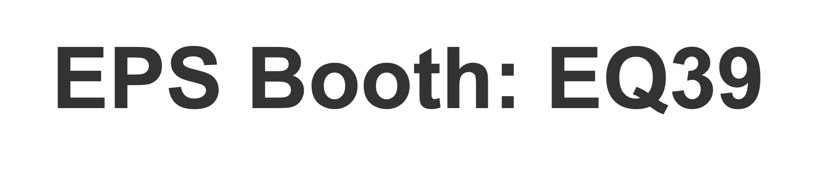
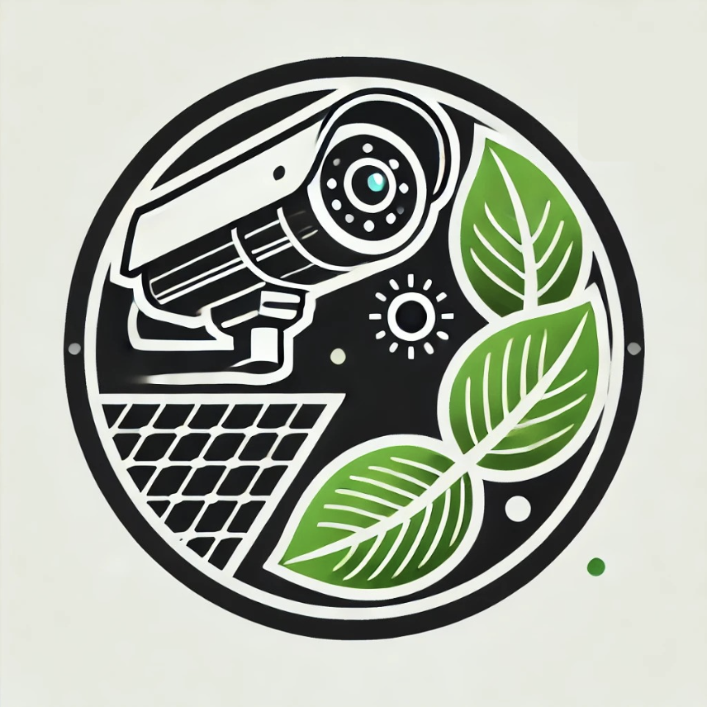
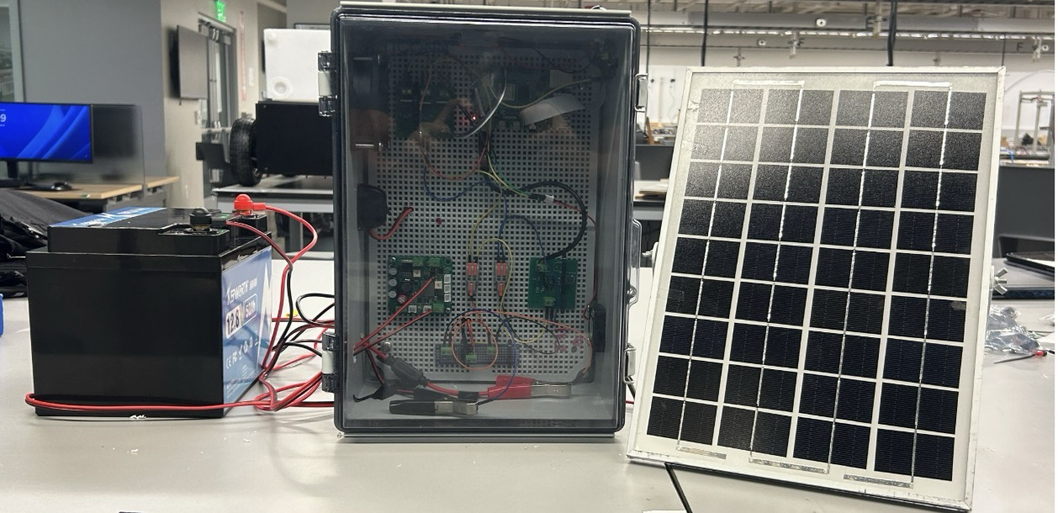
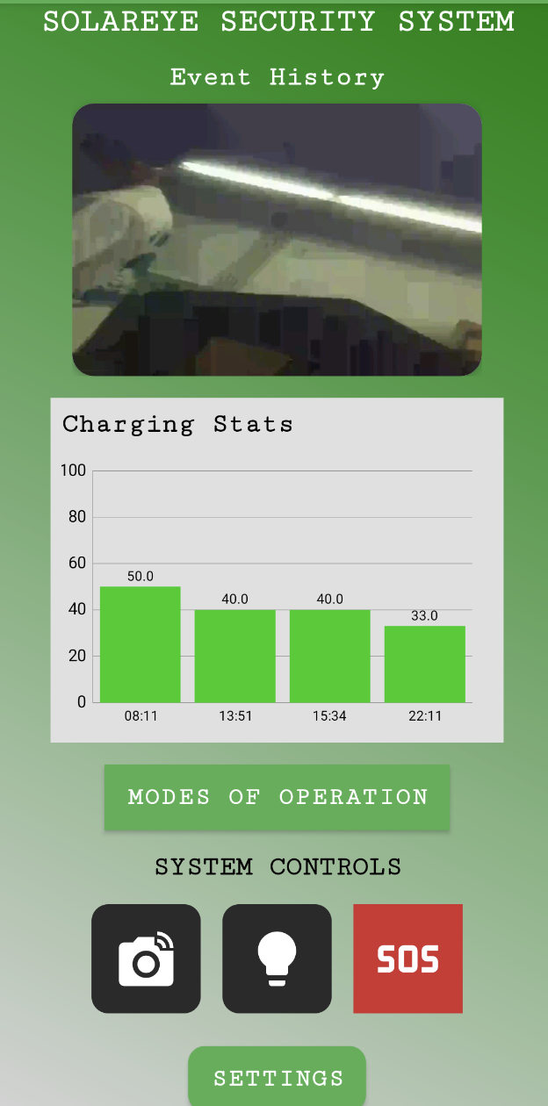


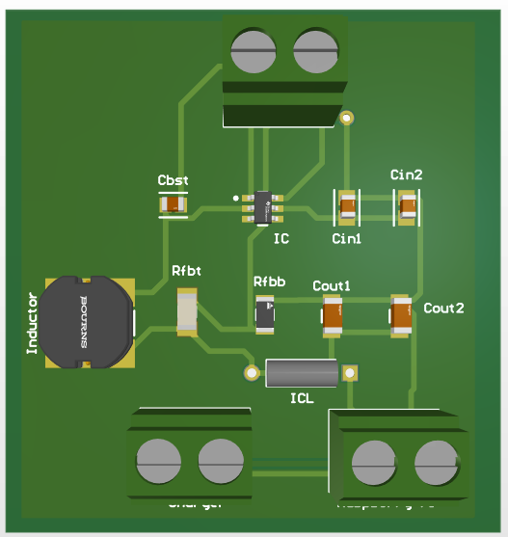
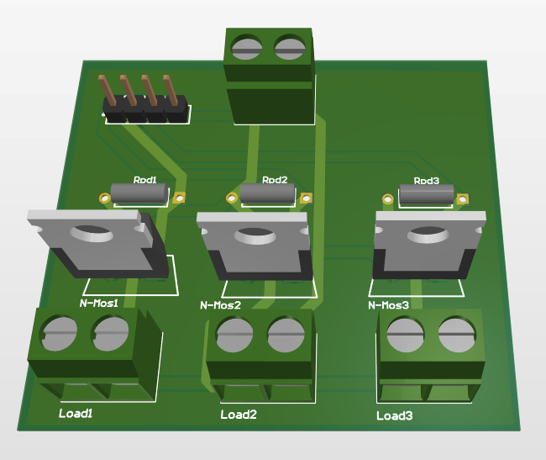
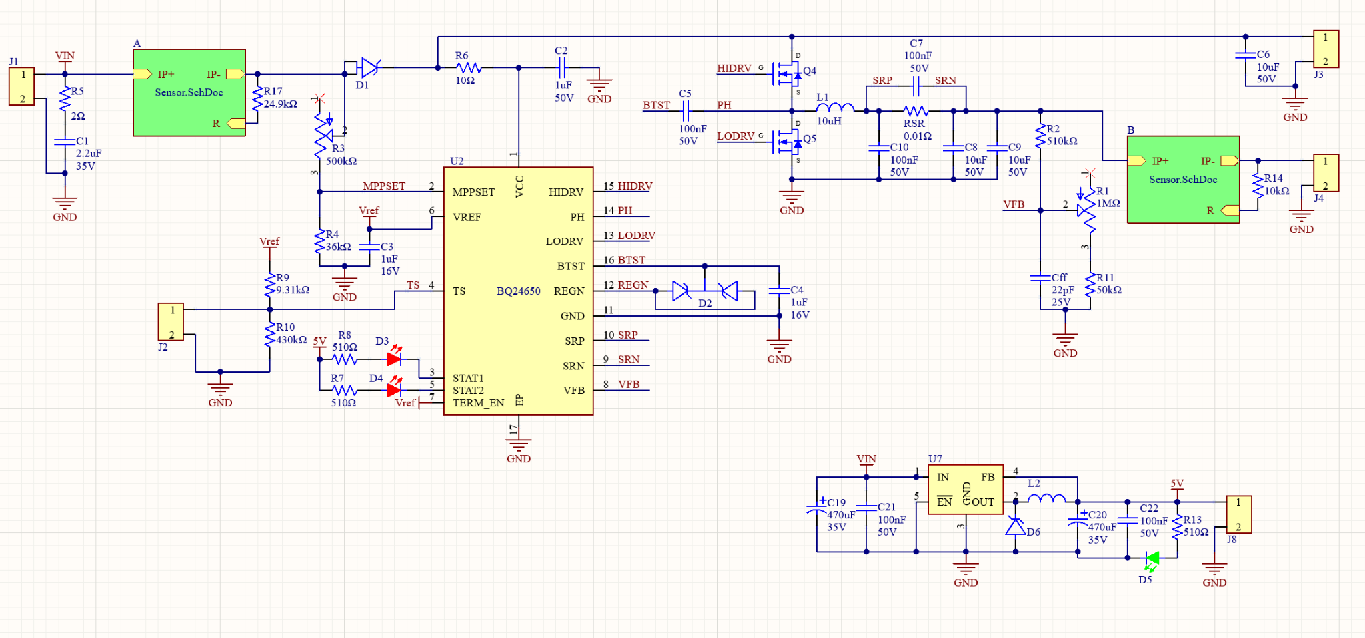
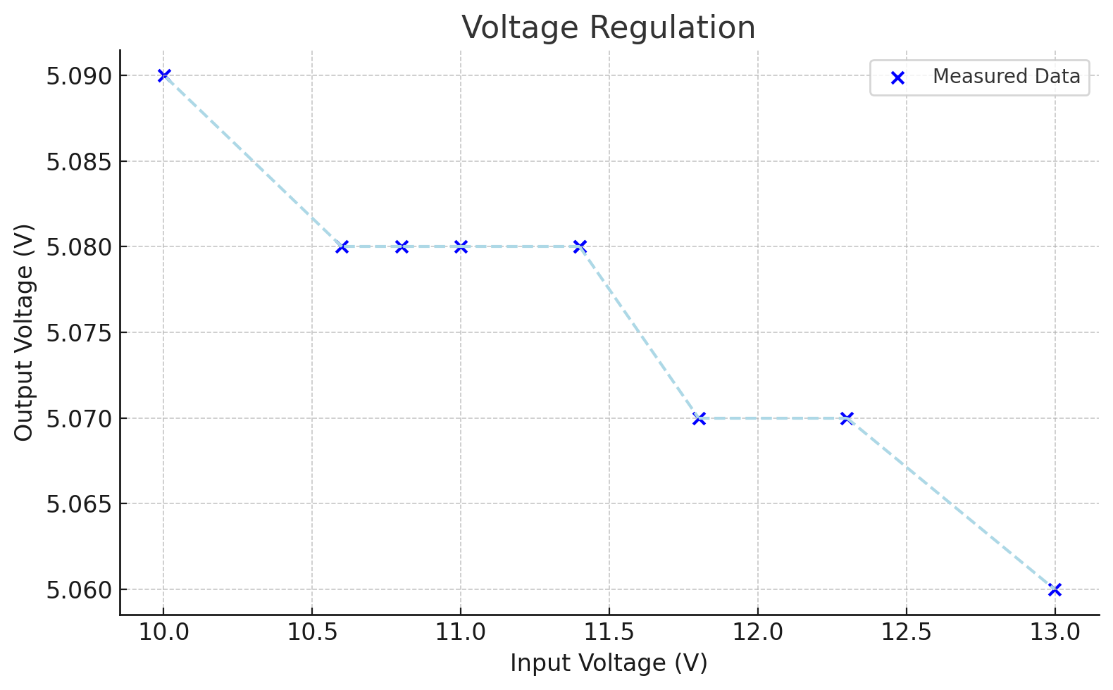
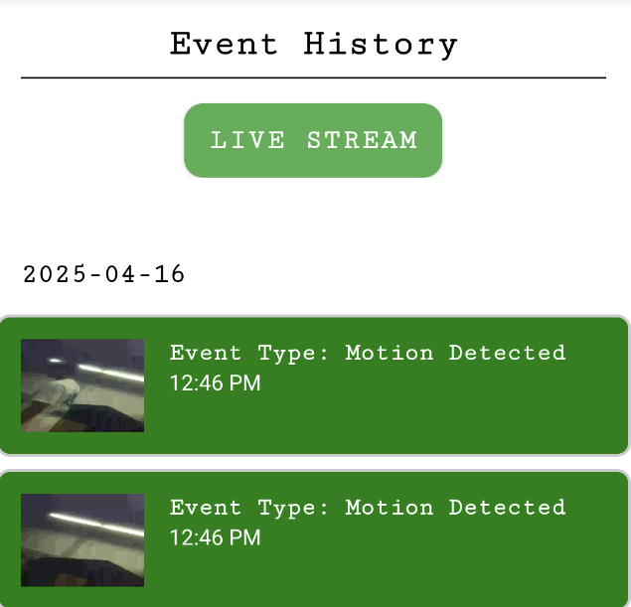
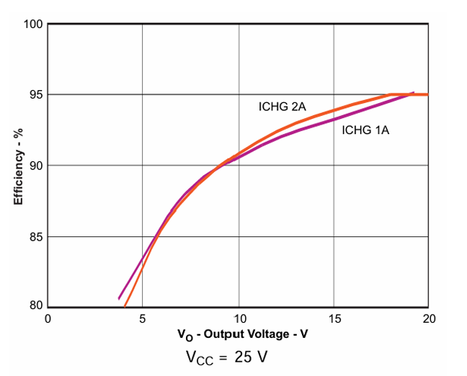
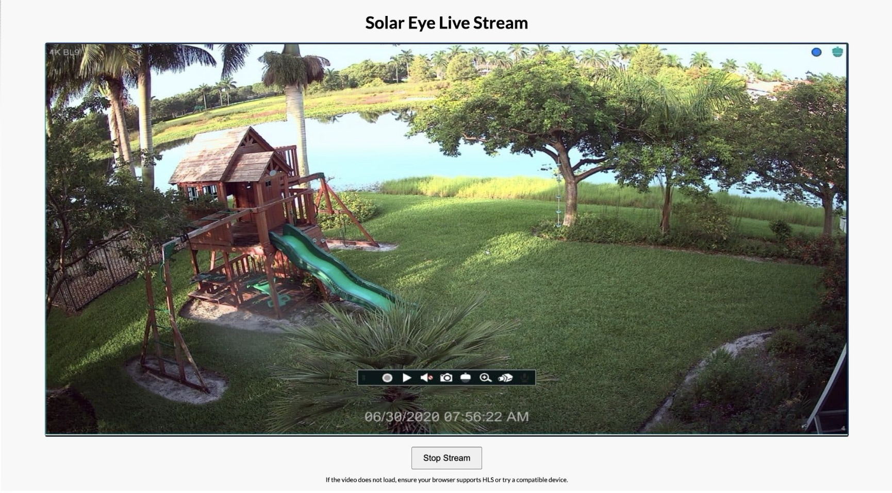
EQ39
SolarEye Security System
Alex Allahar, Zayan Prasla, Jackson Kitchel, Victor Igbokwe
Wonhyeok Jang
Electrical Engineering
System Overiew
An autonomous solar‑powered, motion‑activated camera system that delivers live video feeds and instant app alerts for reliable off‑grid surveillance.
Power Distribution
The Power Distribution system draws from a 12-volt battery, the system employs a buck converter [see Figure 3(A)] to step down the voltage to 5 volts, ensuring stable and efficient power delivery. This regulated 5-volt supply is essential for supplying adequate power to the Raspberry Pi. To enhance functionality, the LED lights and cooling fans are integrated through a dedicated relay control PCB [see Figure 3(B)], which allows the Raspberry Pi to precisely control their operation. This setup enables seamless coordination between power distribution and system control, optimizing performance and efficiency.
A: Buck Converter PCB – Efficiently steps down 12V to a stable 5V supply.
B: Relay Control PCB – Allows the user to control via the Raspberry Pi.
Solar Generation
The Solar power generation subsystem serves as the central power source within our project. The subsystem is responsible for the solar panel, charging circuit PCB and supplying power to the 12-volt battery. The 100W solar panel is connected directly to the charging circuit PCB which regulates the power and supplies the 12-volt battery with a safe and efficient supply voltage. Additionally, the voltage and current supply from the solar panel as well as the battery are monitored by the charging circuit. These data points are then output by the PCB to be read and processed by the Raspberry Pi 4B. The main components of the schematic below are as follows:
A: BQ24650, which serves as the Maximum Power Point Tracking (MPPT) aspect of the circuit
B: ACS723 current sensor IC chips, placed at the input and output of the circuit
SolarEye App
The SolarEye App interfaces with the SolarEye Security System via Firebase, allowing comprehensive control over the system's camera and LED deterrence features. The home page provides an overview of Event History and Charging Statistics for the Solar Panel and Battery. In the Event History section, all recorded events are listed, complete with timestamps and event types. To ensure maximum security, the app's backend is fortified with email verification, two-step authentication, and SMS verification.
Figure 1. System Diagram
Modes of Operation
Low Power Mode (≈ 32.8 h runtime)
Logs only when an event occurs and its duration (no video). Timestamps and durations available in the app; LED deterrence flashes rapidly.
Motion Detection Mode (Default) (≈ 30.7 h runtime)
Continuously monitors via PIR sensor, captures short videos on motion, and uploads them.
Process: PIR → log event → record until 2 s after no motion → save H.264 locally → convert & upload MP4 to Firebase → app shows time stamped video history.
Livestream Mode (≈ 22.2 h runtime)
Provides real‑time video streaming on demand.
Tap “Livestream”; Pi starts HLS streaming and sends the link to the app.
Figure 3. View of Printed Circuit Boards
Figure 5. Solar Power Charging Circuit Schematic
Figure 7. SolarEye App Home Page
Figure 2. Livestream UI Layout
Figure 4. Buck Converter Voltage Regulation graph
Figure 6. Solar Power Charging Circuit Efficiency vs Output Voltage (Taken from MPPT Spec Sheet)
Figure 8. SolarEye App Event History Page
Notes:
A battery-powered IoT security system offering three operation modes that balance power consumption against functionality.

